Slide 1
Network Layer
Logical Addressing

Slide 2
IPv4 ADDRESSES
An IPv4 address is a 32-bit address that uniquely and universally defines the connection of a device (for example, a computer or a router) to the Internet.

Slide 3
The address space of IPv4 is
2³² or 4,294,967,296.

Slide 4

Dotted-decimal notation and binary notation for an IPv4 address
2⁷ 2⁶ 2⁵
128’s 64’s 32’s
2⁴ 2³ 2² 2¹ 2⁰
16’s 8’s 4’s 2’s 1’s

Slide 5

Example
Change the following IPv4 addresses from binary notation to dotted-decimal notation.
2⁷ 2⁶ 2⁵
128’s 64’s 32’s
2⁴ 2³ 2² 2¹ 2⁰
16’s 8’s 4’s 2’s 1’s

Slide 6

Solution
We replace each group of 8 bits with its equivalent decimal number and add dots for separation.

Slide 7

Example
Change the following IPv4 addresses from dotted-decimal notation to binary notation.

Slide 8

Solution
We replace each decimal number with its binary equivalent.

Slide 9

Example
Find the error, if any, in the following IPv4 addresses.

Slide 10
Solution
a. There must be no leading zero (045).
b. There can be no more than four numbers.
c. Each number needs to be less than or equal to 255.
d. A mixture of binary notation and dotted-decimal notation is not allowed.

Slide 11
In classful addressing, the address space is divided into five classes:
A, B, C, D, and E.

Slide 12

Figure 19.2 Finding the classes in binary and dotted-decimal notation

Slide 13
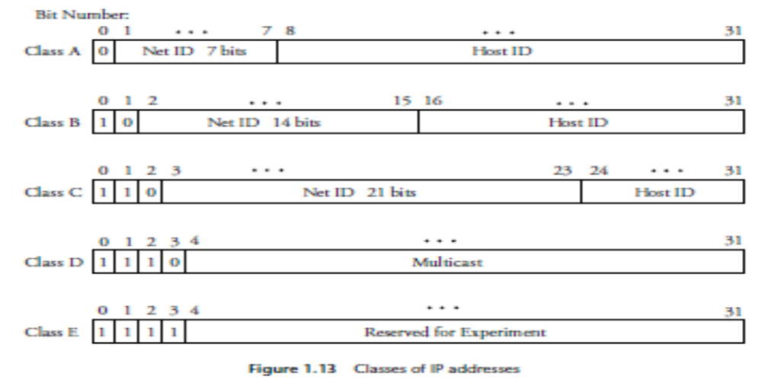

Slide 14
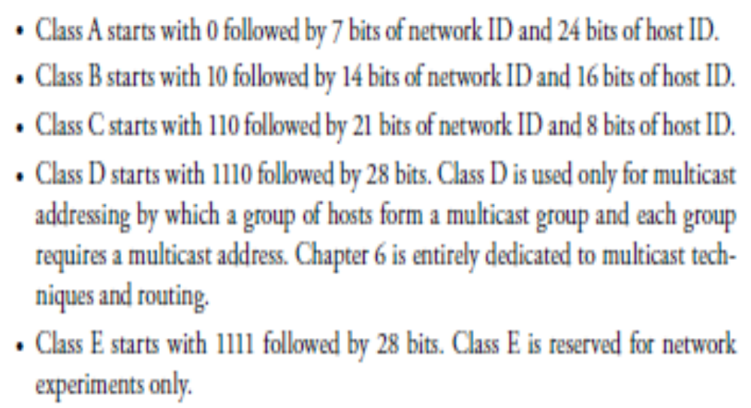

Slide 15
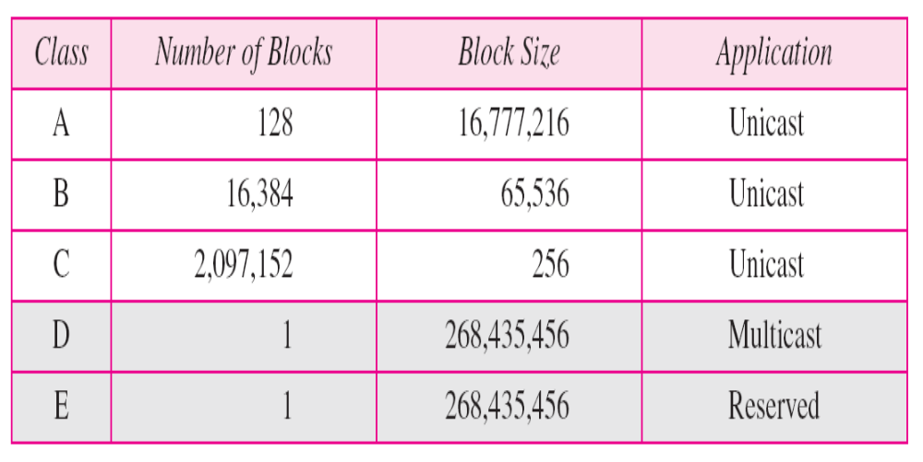
Table 19.1 Number of blocks and block size in classful IPv4 addressing

Slide 16
Example 19.4
Find the class of each address.
a. 00000001 00001011 00001011 11101111
b. 11000001 10000011 00011011 11111111
c. 14.23.120.8
d. 252.5.15.111

Slide 17
Solution
a. The first bit is 0. This is a class A address.
b. The first 2 bits are 1; the third bit is 0. This is a class C address.
c. The first byte is 14; the class is A.
d. The first byte is 252; the class is E.

Slide 18
In classful addressing, a large part of the available addresses were wasted.

Slide 19

Table 19.2 Default masks for classful addressing

Slide 20
Classful addressing, which is almost obsolete, is replaced with classless addressing.

Slide 21
Example 19.5
Figure 19.3 shows a block of addresses, in both binary and dotted-decimal notation, granted to a small business that needs 16 addresses.
We can see that the restrictions are applied to this block. The addresses are contiguous. The number of addresses is a power of 2 (16 = 2⁴), and the first address is divisible by 16. The first address, when converted to a decimal number, is 3,440,387,360, which when divided by 16 results in 215,024,210.

Slide 22

Figure 19.3 A block of 16 addresses granted to a small organization

Slide 23
Classless Addressing
VLSM (Variable Length Subnet Masking)

Slide 24
In IPv4 addressing,
a block of
addresses can be defined as
x.y.z.t /n
in which x.y.z.t defines one of the addresses and the /n defines the mask.

Slide 25

Note
The first address in the block can be found by setting the rightmost
32 − n bits to 0s.

Slide 26
Example 19.6
A block of addresses is granted to a small organization. We know that one of the addresses is 205.16.37.39/28. What is the first address in the block?

Slide 27
Solution
The binary representation of the given address is
11001101 00010000 00100101 00100111
If we set 32−28 rightmost bits to 0, we get
11001101 00010000 00100101 00100000
or
205.16.37.32.

Slide 28
The last address in the block can be found by setting the rightmost
32 − n bits to 1s.

Slide 29
Example 19.7
A block of addresses is granted to a small organization. We know that one of the addresses is 205.16.37.39/28. Find the last address for the block.

Slide 30
Solution
The binary representation of the given address is
11001101 00010000 00100101 00100111
If we set 32 − 28 rightmost bits to 1, we get
11001101 00010000 00100101 00101111
or
205.16.37.47

Slide 31
Note
The number of addresses in the block can be found by using the formula
2^{32−n}.

Slide 32
Example 19.8
Find the number of addresses in 205.16.37.39/28.

Slide 33
Solution
The value of n is 28,
which means that number of addresses is
2 ³²⁻²⁸ or 16.

Slide 34
Example 19.9
Another way to find the first address, the last address, and the number of addresses is to represent the mask as a 32-bit binary (or 8-digit hexadecimal) number. This is particularly useful when we are writing a program to find these pieces of information. In Example 19.5 the 205.16.37.39/28 /28 can be represented as
11111111 11111111 11111111 11110000
(twenty-eight 1s and four 0s).
Find
a. The first address
b. The last address
c. The number of addresses.

Slide 35
Note
The first address in a block is
normally not assigned to any device;
it is used as the network address that represents the organization
to the rest of the world.

Slide 36

Figure 19.6 A frame in a character-oriented protocol

Slide 37
Each address in the block can be considered as a two-level
hierarchical structure:
the leftmost n bits (prefix) define the network;
the rightmost 32 − n bits define the host.

Slide 38

Figure 19.7 Configuration and addresses in a subnetted network

Slide 39

Figure 19.8 Three-level hierarchy in an IPv4 address

Slide 40
Example 19.10
An ISP is granted a block of addresses starting with 190.100.0.0/16 (65,536 addresses). The ISP needs to distribute these addresses to three groups of customers as follows:
a. The first group has 64 customers; each needs 256
addresses.
b. The second group has 128 customers; each needs 128
addresses.
c. The third group has 128 customers; each needs 64
addresses.
Design the subblocks and find out how many addresses are still available after these allocations.

Slide 41
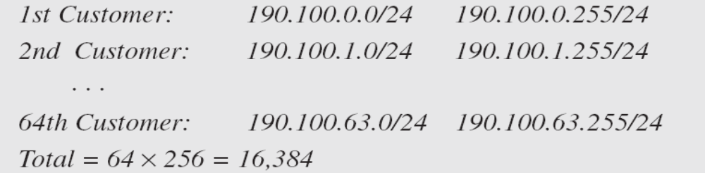
Example 19.10 (continued)
Solution
Figure 19.9 shows the situation.
Group 1
For this group, each customer needs 256 addresses. This means that 8 (log2 256) bits are needed to define each host. The prefix length is then 32 − 8 = 24. The addresses are

Slide 42
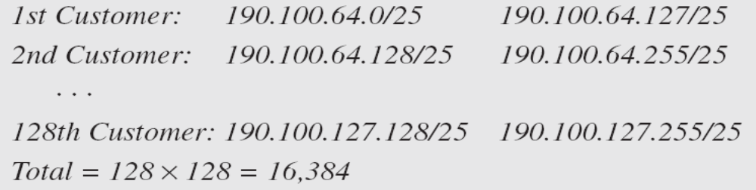
Example 19.10 (continued)
Group 2
For this group, each customer needs 128 addresses. This means that 7 (log2 128) bits are needed to define each host. The prefix length is then 32 − 7 = 25. The addresses are

Slide 43
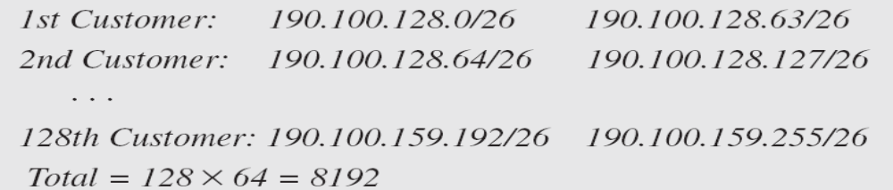
Example 19.10 (continued)
Group 3
For this group, each customer needs 64 addresses. This means that 6 (log₂64) bits are needed to each host. The prefix length is then 32 − 6 = 26. The addresses are
Number of granted addresses to the ISP: 65,536
Number of allocated addresses by the ISP: 40,960
Number of available addresses: 24,576

Slide 44

Figure 19.9 An example of address allocation and distribution by an ISP

Slide 45
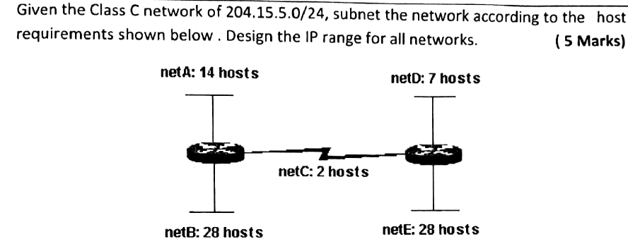

Slide 46
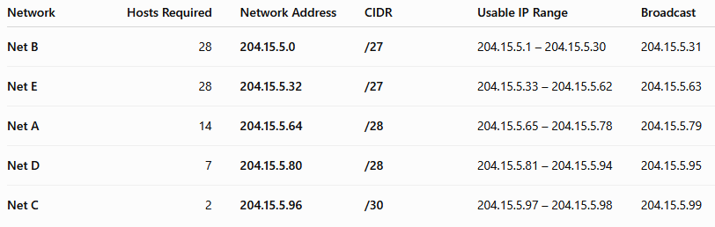

Slide 47
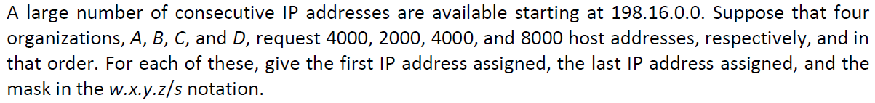

Slide 48
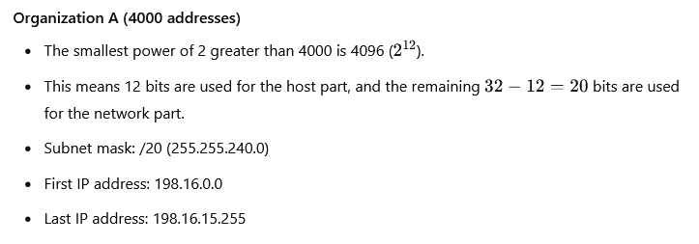

Slide 49
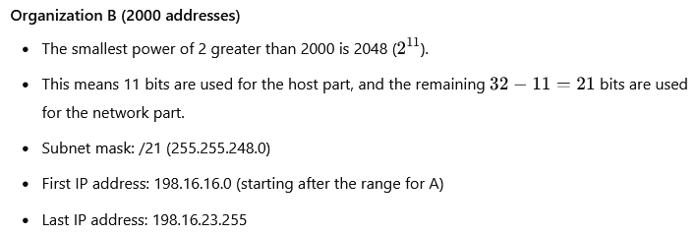

Slide 50
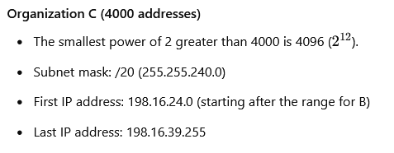

Slide 51
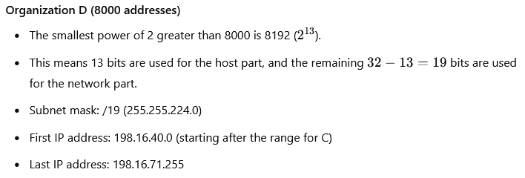

Slide 52
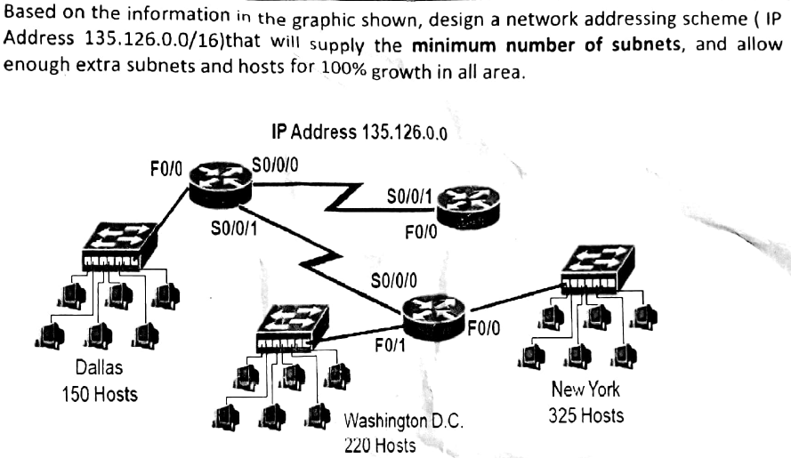

Slide 53
An ISP is granted a block of addresses starting with 150.80.0.0/16. The ISP wants to distribute these blocks to 2600 customers as follows.
a. The first group has 200 medium-size businesses; each needs 128 addresses.
b. The second group has 400 small businesses; each needs 16 addresses.
c. The third group has 2000 households; each needs 4 addresses.
Design the sub blocks and give the slash notation for each sub block. Find out how many addresses are still available after these allocations.

Slide 54

Table 19.3 Addresses for private networks

Slide 55

Figure 19.10 A NAT implementation

Slide 56

Figure 19.11 Addresses in a NAT

Slide 57

Figure 19.12 NAT address translation

Slide 58

Table 19.4 Five-column translation table

Slide 59

Figure 19.13 An ISP and NAT

Slide 60
19-2 IPv6 ADDRESSES
Despite all short-term solutions, address depletion is still a long-term problem for the Internet. This and other problems in the IP protocol itself have been the motivation for IPv6.
Topics discussed in this section:
Structure
Address Space

Slide 61
An IPv6 address is 128 bits long.

